Slide 1
INTRODUCTION TO DB2

Slide 2
TOPICS COVERED
DB2 Introduction
NORMALIZATION
DDL

Slide 3
DB2 is an abbreviation for ‘IBM DATABASE 2”
DB2 is a subsystem of the z/OS Operating System
It is a database relational management system (DBRM) – RDBMS (Relational Database Management System)
Id name loc salary
Numeric char char decimal
1001 tommy chennai 90000
It is a system that allows any number of z/OS users to access any number of relational databases by means of the well-known relational language SQL

Slide 4
What is Data ?
Data is a collection of Facts/Information.
What is Database ?
It is a self describing collection of Integrated data.
( Data + Application Program).
What is DBMS?
It is a system (hardware + software) that creates and manipulates the collection of inter-related data.
What is RDBMS?
It is a tool for organizing and manipulating data that is stored in a TABLE like structure.
E.g.: DB2, Oracle, Sybase etc.

Slide 5
WHAT IS DATA AND INFORMATION
Information is nothing but refined data and is the backbone of an organization.
Consists of
  Data
  Images
  Documents
  Even voice

Slide 6
NORMALIZATION
It is a technique that allows the designer to detect redundancies in a given table.
It is used to check the data and/or design your tables.
Notes:
The next topic is about Normalization.
What is Normalization?
- A technique that allows the designer to detect redundancies in a given table.
- It is used to check the data and/or design your tables.
- Generally this technique is used to eliminate the redundancies from the table (OR)
- It is process of steps that will identify for elimination of redundancies in a database design.

Slide 7
NORMALIZATION
After you define entities and decide on attributes for the entities, you normalize entities to avoid redundancy.
Normalization helps you avoid redundancies and inconsistencies in your data.
It is a paper and pen work, not codes.

Slide 8
NORMALIZATION
FIRST NORMAL FORM
SECOND NORMAL FORM
THIRD NORMAL FORM

Slide 9
NORMALIZATION
Norm I-Eliminate Repeating Groups.
Norm II-Eliminate all columns that depend only on part of the key.
Norm III - Eliminate columns not dependent on the key at all.

Slide 10
NORMALIZATION
The rules for normal form are cumulative.
In other words, for an entity to satisfy the rules of second normal form, it also must satisfy the rules of first normal form.
An entity that satisfies the rules of third normal form also satisfies the rules of first and second normal forms.

Slide 11
NORMALIZATION
UN-NORMALIZED TABLE
Empno | Name | Work Dept | Dept name | Skill 1 | Skill 2 | Skill 3 | Skill n
030 250 270 300 | SAM TOM TIM SID | C01 D21 E11 D21 | MKET PURCH HR PURCH | 141 002 415 011 | 011 447 032 | 067

Slide 12
NORMALIZATION
I - NORMAL FORM
Eliminate Repeating Groups.
EMPNO | NAME | WORKDEPT | DEPTNAME
030 250 270 300 | SAM TOM TIM SID | C01 D21 E11 D21 | MKET PURCH HR PURCH
Empno | Name | Work Dept | Dept name | Skill 1 | Skill 2 | Skill 3 | Skill n
030 250 270 300 | SAM TOM TIM SID | C01 D21 E11 D21 | MKET PURCH HR PURCH | 141 002 415 011 | 011 447 032 | 067
EMPNO | SKILLNO | SKILLDESC
030 250 250 250 270 270 300 300 | 141 002 011 067 415 447 011 032 | RESEARCH BIO PREP NEGOTATION PRODUCT SPEC BENEFITS ANALYSIS TESTING NEGOTATION INVENTORY CONTROL
REPEATED GROUPS
EMP TABLE
SKILL SET TABLE

Slide 13
NORMALIZATION
II - NORMAL FORM
Eliminate all columns that depend only on part of the key.
EMPNO | SKILLNO
030 250 250 250 270 270 300 300 | 141 002 011 067 415 447 011 032
EMPNO | SKILLNO | SKILLDESC
030 250 250 250 270 270 300 300 | 141 002 011 067 415 447 011 032 | RESEARCH BIO PREP NEGOTATION PRODUCT SPEC BENEFITS ANALYSIS TESTING NEGOTATION INVENTORY CONTROL
SKILLNO | SKILLDESC
141 002 011 067 415 447 011 032 | RESEARCH BIO PREP NEGOTATION PRODUCT SPEC BENEFITS ANALYSIS TESTING NEGOTATION INVENTORY CONTROL
Skill description depends on skill no. and not the empno, which is the primary keySKILLNO
Skill table
Skill description table

Slide 14
NORMALIZATION
II - NORMAL FORM
Eliminate columns that is not dependent on the key at all.
EMPNO PK | NAME | WORKDEPT
030 250 270 300 | SAM TOM TIM SID | C01 D21 E11 D21
WORKDEPT | DEPTNAME
C01 D21 E11 D21 | MKET PURCH HR PURCH
DEPTNAME does not depend on EMPNO(PK)
EMP table
DEPT table

Slide 15
DENORMALIZATION
Denormalization is the opposite of normalization process.
It is the process of putting one fact in many places to enhance the speed of data retrieval at the expense of data modification.
This is not necessarily a bad decision, but should be undertaken only when a completely normalized design will not perform optimally.

Slide 16
DENORMALIZATION
Issues to be considered before denormalizing:
1. Can the system achieve acceptable performance without denormalizing?
2. Will denormalization render the database design unusable for ad hoc queries (that is, specialized expertise required to code queries against the denormalized design)?
3. Will the performance of the system still be unacceptable after denormalizing?
4. Will the system be less reliable due to denormalization?
If the answer to any of these questions is "yes," you should not denormalize your tables because the benefit will not be much.

Slide 17
DB2 DATABASES ARE RELATIONAL
A relational database is a database that is perceived by
its users as a collection of tables (related as well as unrelated).
Empid | Ename | Dno fk | Projectid fk
01 | John | 20 | P01
02 | Peter | 10 | P02
03 | Walter | 30 | P04
04 | tommy | 10 | p01
ON Delete rules.
Defined in the child table.
Will be activated when deletion happens
in the Parent table.
1. cascade-delete those depending employees.
2. Set null – the depending column
3. Restrict – deletion IS STOPPED
from the parent table, if there are depending
records in the child table.
pid -pk | client | pm
P01 | icici | Tom
P02 | hdfc | Jim
p04 | hsbc | Jerry
Did -pk | Dname | HOD
10 | Mkt | Tom
20 | Sales | Jim
30 | Dev | Jerry
40 | Accounts | Harris

Slide 18
DB2 DATABASES ARE RELATIONAL
Empid | Ename | Dno fk | Projectid fk
01 | John | 20 | P01
02 | Peter | 10 | P02
03 | Walter | 30 | P04
04 | tommy | 10 | p01
pid -pk | client | Ploc fk
P01 | icici | india
P02 | hdfc | us
p04 | hsbc | uk
Ploc pk | state | phone
india | Tamil nadu | 4565432132
Us | Texas | 457878789
uk | Welsh | 78787878

Slide 19
WHAT IS RELATION?
  “ Relation” is just a mathematical term for a table.
  Relational systems are based on what is called the relational model of data
  The principles of the relational model introduced by Dr. E F Codd – IBM researcher.
All the RDBMS follows CODD's Relational rules 12 rules

Slide 20
CODD’S 12 RULES.
Information rule
Guaranteed Access rule
Systematic treatment of NULLs rule
Active on-line catalog based on relational model
Comprehensive data sub-language rule
View Updating rule

Slide 21
CODD’S 12 RULES. (CONT … )
High-level Insert, Update and Delete
Physical data independence
Logical data independence
Integrity independence
Distribution Independence
Non-subversion rule

Slide 22
OTHER DATABASES
Apart from Relational Data Base, We have
Hierarchical Data Base and
Network Database

Slide 23
HIERARCHICAL
  Top down structure resembling an upside-down tree
  Parent child relationship
  First logical database model
  Available on most of the Mainframe computers
  Example – IMS

Slide 24
NETWORK
  Does not distinguish between parent and child. Any record type can be associated with any number of arbitrary record types
  Example - IDMS

Slide 25
DATA OBJECTS
Stogroup, tablespace, database
Sec mem volumes. Alwyn1,alwyn2,alwyn3,alwyn4
Storage Group
It’s a set of volume on single DASD→ hdd
Create stogroup stg1 using alwyn1,alwyn2.
Partitioned storage group is table space.
Temp buffer → bufferpools.
bp01,bp02
Create database shrdb4 using stg1,bp01,bp02;
Database
It contains a stogroup & bufferpool
Create tabelemp (in char(03)) in shrdb4.shrts4;

Slide 26
Tablespace
Logical address space on secondary storage
to hold one or more tables
A ‘SPACE’ is basically an extendable collection of pages with each page of size 4K or 32K bytes. (K=1024)
Three Type of Tablespaces –
Simple: Can contain more than one table. Usually only one is preferred.
2. Partitioned : (a)The table space is divided into equal partitions.
(b)The entire table space can have only one table.
(c)Utilities can be run on one partition.
3. Segmented : The table space is divided into equal segments.
Each Segment can have only one table.

Slide 27
RDBMS Terminologies
  Data Structure
  Data Integrity

Slide 28
RDBMS Terminologies – Data Structures
Table – Relation
Record – Tuple/Row
Attribute – Field/Column
Domain : A range of values (pool) of same column.
Entity : some object about which we wish to store
information. Employee is the entity for a
table in which information about him is
stored.
NULL : represents an unknown /empty value.
Atomic Value : smallest unit of data ; the individual data value.

Slide 29
RDBMS Terminology : Data structures
Degree - The number of attribute in a relation is called
the degree of the relation.
A relation of degree two is called binary.
Cardinality - The number of tuples or rows in a relation is
called the cardinality of the relation.
The Cardinality of the relation keeps changing with time as more and more tuples get added or deleted, but the degree does not.
(Substantiate the above statement)

Slide 30
RDBMS Terminology : Data Integrity
  Entity Constrains
  Referential constrains
  NULL Constrains

Slide 31
ENTITY CONSTRAINS
  Constrains(Conditions/Rules) can be written
for a column while creating a table.
  The value that does not satisfy the constrains will not be accepted while inserting a record in to a table.
        CHECK
        UNIQUE

Slide 32
ENTITY CONSTRAINS
CHECK
- any condition can be written along with the attribute definition.
EX.
CREATE TABLE EMP
( ENO NUM NOT NULL,
AGE NUM CHECK (AGE > 30))
IN DB.TS
While inserting a record with age =20, the system will not allow the record to be inserted because the check condition says that age must be greater than 30

Slide 33
ENTITY CONSTRAINS
UNIQUE
    This is written along with table creation.
    It just ensures that INSERT operation is successful only if that particular attribute has a UNIQUE value.
        CREATE TABLE EMP
    (ENO …,
    TEL NUM UNIQUE)
    IN DB.TS
    The above SQL statement will never allow duplicate values to inserted for TEL column.

Slide 34
RDBMS TERMINOLOGY :
REFERENTIAL CONSTRAINS
Candidate key :
  set of attributes which uniquely identify the row
Primary Key :
  is an attribute of user’s choice from the
  candidate key. It provides a way to identify
  each row in the table.
Alternate key :
  Remaining candidate keys that were not chosen as
  primary key.

Slide 35
RDBMS TERMINOLOGY :
REFERENTIAL INTEGRITY
Foreign key
is column(s) in a table whose values have matching values in primary key columns in another table, providing a way to establish relationship between tables.
Referential Constraint
The limiting of a set of foreign key values (of a child table) to a set of primary key values (of its corresponding parent table).
Referential Integrity
The automatic enforcement of referential constraints.

Slide 36
EMPLOYEE
Emp No (PK) | Emp Name | Dept NO (FK) | Salary
001 | John | 01 | 85654
002 | Peter | 02 | 56322
003 | Walter | 01 | 85654
DEPT
Dept No(PK) | Dept Name | Location(FK)
01 | Sales | Chennai
02 | Account | Delhi
03 | Mkt | Pune
04 | Training | Mumbai
Address
Location (PK) | Address 1 | Address 2 | Address 3
Chennai | Infoville | Perungudi | 600034
Delhi | Techno | New delhi | 110236
Mumbai | Mofin | Thane | 300326
Pune | Surya plaza | Navipeth | 311042

Slide 37
RDBMS TERMINOLOGY :
REFERENTIAL INTEGRITY
The table which has a FOREIN KEY definition is the CHILD/ DERIVED table. Eg. EMPLOYEE, DEPT.
The corresponding tables in which these FOREIGN KEY attributes are declared as PRIMARY KEY are called PARENT/BASE table. Eg. DEPT is the parent table for EMPLOYEE table and LOCATION table is the parent table of DEPT table.
DEPT table is both, a child table as well as a parent table for two different tables.
LOCATION table is BASE/PARENT only.
EMPLOYE table is CHILD/DERIVED table only.

Slide 38
RDBMS TERMINOLOGY :
REFERENTIAL INTEGRITY
Every foreign key value must have a matching primary key value.
An insert into a foreign key table cannot violate
referential integrity.
Deletion of a primary key value cannot violate
referential integrity.
Notes:
In last slide we discussed that referential integrity will automatically enforce the referential constrains for every foreign key value must have a matching primary key value.
When will system enforce this referential integrity?
An insert into a primary key table cannot violate referential integrity and no checking is require
Deletion of a foreign key value cannot violate referential integrity and no checking is required
The insertion of any given foreign key value or an update to that value is allowed only if the matching value exists in the primary key
Changes in primary key values are allowed only for those values that do not have matching foreign key values

Slide 39
RDBMS TERMINOLOGY :
REFERENTIAL INTEGRITY
The insertion of any given foreign key value or an update to that value ( in child table) is allowed only if the matching value exists in the primary key (of the corresponding parent table).
Changes in primary key values are allowed only for
those values that do not have matching foreign key
values.
Notes:
In last slide we discussed that referential integrity will automatically enforce the referential constrains for every foreign key value must have a matching primary key value.
When will system enforce this referential integrity?
An insert into a primary key table cannot violate referential integrity and no checking is require
Deletion of a foreign key value cannot violate referential integrity and no checking is required
The insertion of any given foreign key value or an update to that value is allowed only if the matching value exists in the primary key
Changes in primary key values are allowed only for those values that do not have matching foreign key values

Slide 40
ON DELETE RULES
1. SET NULL
2. CASCADE
3. RESTRICT

Slide 41
ON DELETE RULES
Deletion of a primary key (in parent table) value when
corresponding foreign key (in child table) value exists
Will ::
set the corresponding foreign key values to null if the constraint has been specified as SET NULL.
2. cause deletion of the corresponding rows containing
  foreign key if the constraint has been specified as
  CASCADE.
3. be barred if the foreign key constraint has been
specified as RESTRICT.(deletion operation will not be
allowed )
Notes:
So in last slide we have seen that the deletion of primary key value will affect the child table values. So what should do, whether to allow the change or not. If allows what value will change in child table.
This change will be done as per the deletion constrain, which should be given along with the foreign key while creating it. That deletion constrains are as follows.
Restrict the changes both in Child and Parent table
will be barred if the foreign key constraint has been specified as RESTRICT
Delete the records in child table that associated with the deleted records in parent table.
will cause deletion of the corresponding rows containing foreign key if the constraint has been specified as CASCADE
Change Null value in respective field of the records in child table that associated with the deleted records in parent table.
will set the corresponding foreign key values to null if the constraint has been specified as SET NULL

Slide 42
RDBMS TERMINOLOGY : NULL CONSTRAINS
Missing or Unknown information can be represented in RDBMS through a NULL value.
NULL is neither zero nor spaces but just that the value is unknown.
DB2 automatically moves the following values
Zero (0) for Numeric Field
Blanks (spaces) for Alphanumeric or Alpha
Notes:
Next NULL Constrain.
This tern NULL has been crossed in many place so for.
What is NULL?
Missing or Unknown information can be represented in RDBMS through a NULL value.
So Is it zero or blank space?
No its not,
NULL is neither zero nor spaces but just that the value is unknown.
So in RDBMS, there is some systematic treatment to handle this null values.
System will handle the null values. Then what is there for us?
Our part is to intimate which are all the columns may contain NULL values. Or may not contain the NULL values or even if NULL values are present what value should store in that column by default.
So to do this we implements NULL constrains during the Table creation using null constrains
Allow NULL
Will allow the Null values in the column. This option is default in the table creation. that is, if NULL constrain is omitted during the table creation, that column will consider as allow null constrain.
2.Not NULL
This constrain won’t allow the NULL values in the Column. So all primary key fields must be defined with this constrain.
3. Not NULL with Default.
This constrain will allow the values which we enter in the table. In the absents of value, it won’t allow the null values instead of it will store the default value in the column as we specified

Slide 43
RDBMS TERMINOLOGY : NULL CONSTRAINS
  Allow NULL
  NOT NULL
  NOT NULL WITH DEFAULT
NOT NULL WITH DEFAULT “ XYZ”
Notes:
Next NULL Constrain.
This tern NULL has been crossed in many place so for.
What is NULL?
Missing or Unknown information can be represented in RDBMS through a NULL value.
So Is it zero or blank space?
No its not,
NULL is neither zero nor spaces but just that the value is unknown.
So in RDBMS, there is some systematic treatment to handle this null values.
System will handle the null values. Then what is there for us?
Our part is to intimate which are all the columns may contain NULL values. Or may not contain the NULL values or even if NULL values are present what value should store in that column by default.
So to do this we implements NULL constrains during the Table creation using null constrains
Allow NULL
Will allow the Null values in the column. This option is default in the table creation. that is, if NULL constrain is omitted during the table creation, that column will consider as allow null constrain.
2.Not NULL
This constrain won’t allow the NULL values in the Column. So all primary key fields must be defined with this constrain.
3. Not NULL with Default.
This constrain will allow the values which we enter in the table. In the absents of value, it won’t allow the null values instead of it will store the default value in the column as we specified

Slide 44
DB2 - DATA TYPES
DATA TYPES
NUMERIC
STRING
DATE/TIME
CHARECTORS
GRAPHICS
SMALL INT
DECIMAL
INTEGER
NUMBER
FLOAT
REAL
DATE
TIME
TIME STAMP
CHAR
VARCHAR
LONG VARCHAR
GRAPHIC
VARGRAPHIC
LONG VARGRAPHIC

Slide 45
DB2 – DATA TYPES
NUMERIC
Char (n) 1 < n < 254 bytes
Varchar(n) variable length
Smallint 2 bytes +- 32 K
Integer 4 bytes +- 2 GB
Decimal(x,y) max 31 digits
Date 0001-01-01
Time 00:00:00
Timestamp 0001-01-01-00.00.00.000000
Notes:
Data types:
Each value in a table has a data type. The data type indicates how value is represented in
storage . All the values in a given column have the same data types , which is the data
type of the column.
The data type of a column determines what you can and cannot do with it. For example,
you cannot insert character data, like a last name, into a column whose data type is
numeric.
The data types are divided into three general categories: string, numeric, and datetime.

Slide 46
DB2 – DATA TYPES
STRING
CHAR(n)
CHARACTER(n) - Fixed –length character string. N is the number of characters.
VARCHAR(n) - Variable-length character string. N is the maximum number of characters.
GRAPHI(n) - Fixed – length graphic string. N is the number of characters.
CARDGRAPHIC(n) - Variable-length graphic string. N is the maximum number of characters.

Slide 47
DB2 – DATA TYPES
DATE/TIME
DATE – Designates a point in time according to the
Gregorian calendar.
TIME -- Designates a time of day according to a 24
hours clock. HH:MM:SS: mS:mS.
TIME STAMP – Designates TIME and DATE

Slide 48
STRUCTURED QUERY LANGUAGE
Introduction
Characteristics
Components and
Data Types

Slide 49
SQL INTRODUCTION
(STRUCTURED QUERY LANGUAGE)
Consists of set of facilities for defining, accessing and managing relational databases.
SQL can be invoked either interactively(spufi,qmf), or by embedding them in application programs(cobol).
Very flexible

Slide 50
ADVANTAGES OF SQL
Provides greater degree of abstraction than procedural languages.
Enables end-users to deal with multiple number of databases at the same time.
Specifies what is required and not how it should be done.

Slide 51
PURPOSE AND USE OF SQL
Query
Definition of data structures
Controlling access to the data
Delete/Modify occurrences of the data.

Slide 52
DB2 COMPONENTS
DDL Data Definition Language
DML Data Manipulation Language
DCL Data Control Language
TCL Transaction Control Language
DQL DATA QUERY LANGUAGE
        SELECT

Slide 53
DDL – DATA DEFINITION LANGUAGE
Create – Create schema objects
Alter – Alter Schema objects
Drop – Delete schema objects.
Rename – Rename the schema object.
TRUNCATE – TO EMPTY THE TABLE.
Schema Object: Tables, Vews, Indexes, Triggers Etc,.

Slide 54
DML – DATA MANIPULATION LANGUAGE
Insert – Add new rows into the table
Update – Modify values in the existing rows
Delete – Removing already existing rows
Select – Retrieving records from table.

Slide 55
DCL – DATA CONTROL LANGUAGE
Grant – Grant privileges and roles
Revoke – Take away privileges.

Slide 56
TCL – TRANSACTION CONTROL LANGUAGE
COMMIT – Saves all the transaction till that point where Commit command is given
ROLLBACK – It is like UNDO command. It saves only till the previous commit

Slide 57
INTERACTING DB2 WITH SPUFI
Now we will discuss about how to communicate with DB2 with SPUFI
In ISPF panel choose option 8 for DB2 as follows

Slide 58
How to execute SQL with SPUFI
  Step 1
  Login to TSO region. Create a PDS for all the DB2 source codes and a member in it for Input data set. Create a PS for the outputs (output data set) of the SQL statements to be displayed.
  Step 2
  Select 8.1 option in ISPF main menu.
  Step 3
  Specify the Input dataset and Output Dataset for the SQL Query and result of the Query.
  Step 4
  Now Give the SQL query for executing.
  Step 5
  Type END;;; or press F3 for execution of the query.

Slide 59
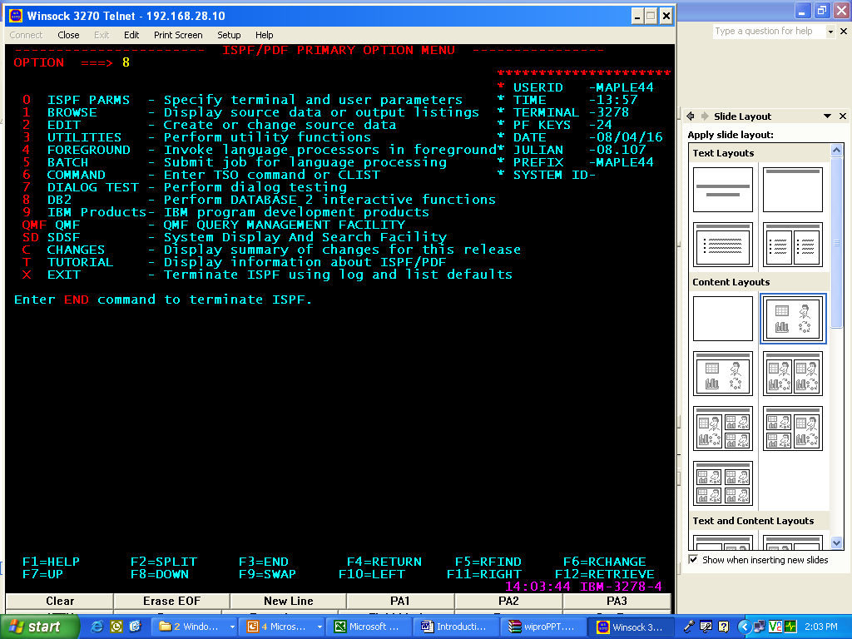
Select option 8 for DB2

Slide 60
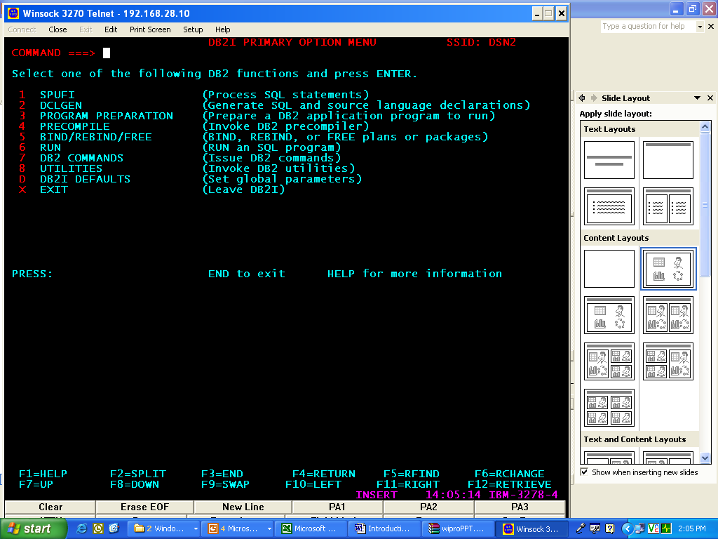
Select option 1 for SPUFI
(or)
Type 8.1 option directly in main menu

Slide 61
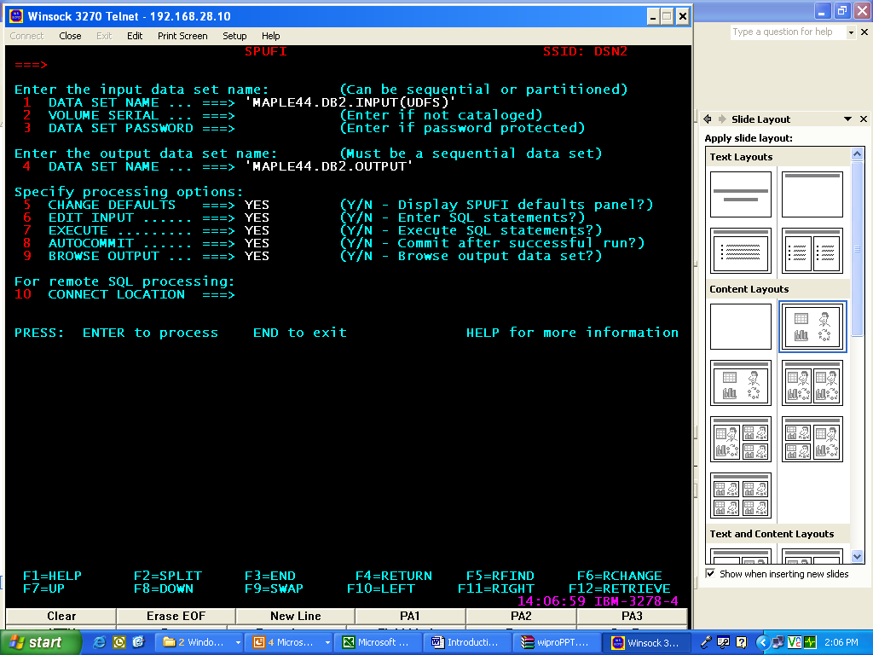
Type the output dataset name (PS dataset)
Type the Input dataset name
(PDS Data Set)

Slide 62
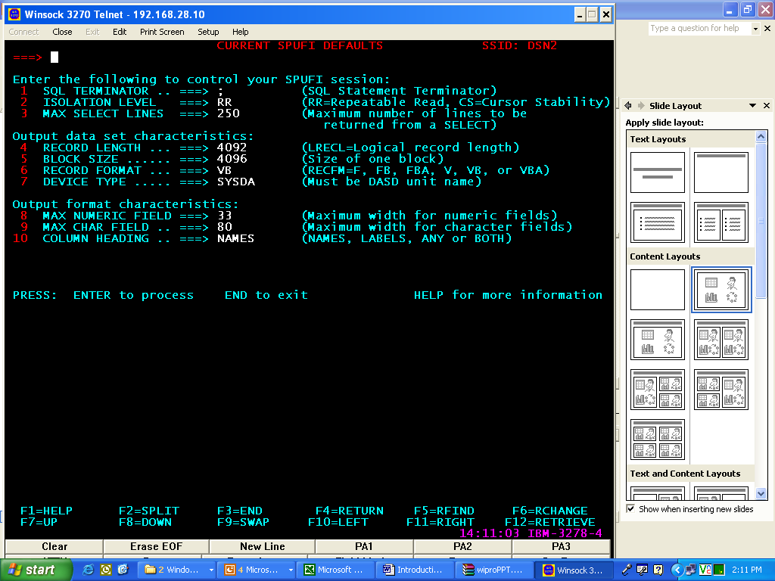
Give the settings as per our requirement then press enter

Slide 63
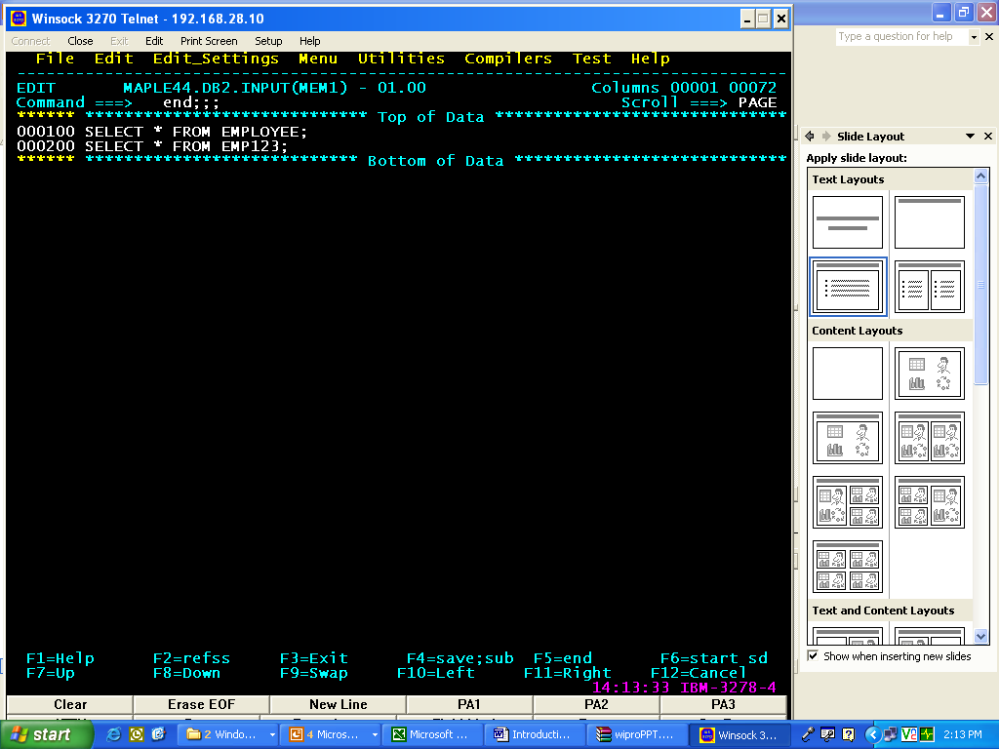
Give the queries to be executed
Type END;;; for execution of these queries

Slide 64
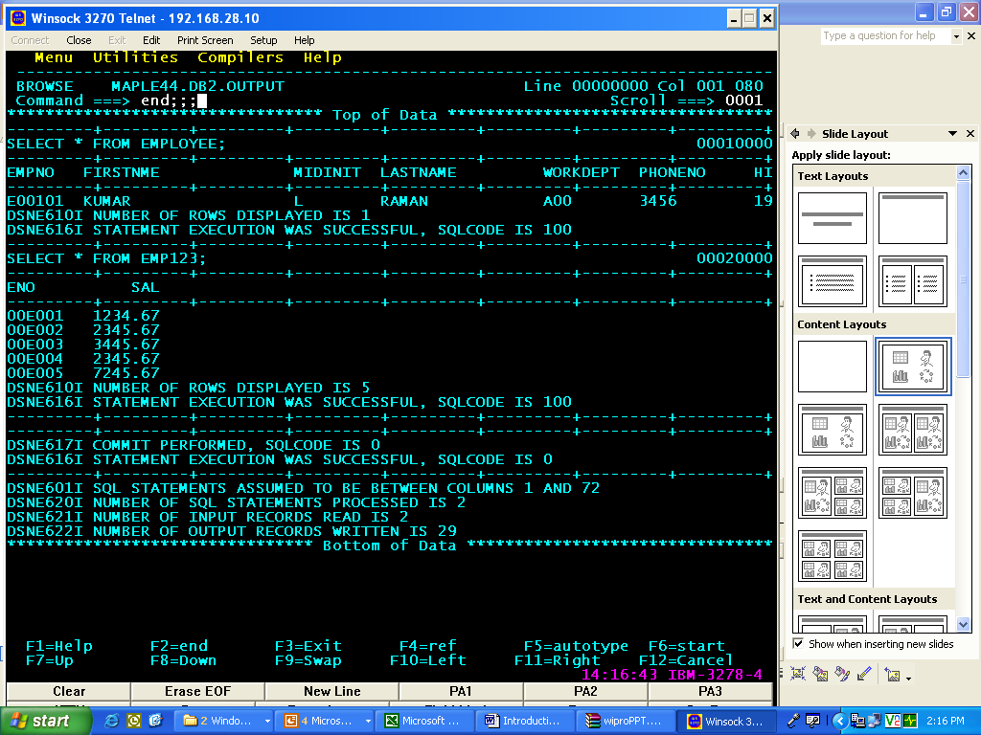

Slide 65
SQLCODE: the system will throw a Numeric code that reflects the status of the SQL statement that is executed.
The SQLCODE will be negative for ERRORS.
The SQLCODE will be positive for Warnings and information.
The SQLCODE will be zero for successful execution.

